Slide 1
DIVA Digital and International Virtual Academic Cooperation
Outcomes
Prof. Dr. Anselm Böhmer, Illie Isso MA, Hilal Sahin

Slide 2
What has happened so far! …here is the current status!

Slide 3
Minutes of the accompanying open office hours on wonder.me
…some excerpts from the protocol
Student 1: „(…) asks himself intensively how he should or can integrate the topic (epistemology in the context of inter- and transcultural educational processes) into his future work as a teacher. Specifically: What does epistemology have to do with the teaching profession?“
Student 2: „(…) Problems with the group organisation are also discussed, as one student (…) does not report. The time differences (approx. 6.5 hours) between Germany and Australia are also discussed and the difficulties they cause.“
Students 3 and 4: „(…) some organisational questions at the beginning of the meeting. Such as: Which requirements have to be handed in at what time? Or: How long the cooperation with the students from Darwin will last.“
Student 5: „The cooperation with (team member) was bad due to their poor internet connection. Student 5 had set up "padlet" for group communication, for thoughts while reading and working on the tasks.“

Slide 4
Some products that the students have created in cooperation…

Slide 8
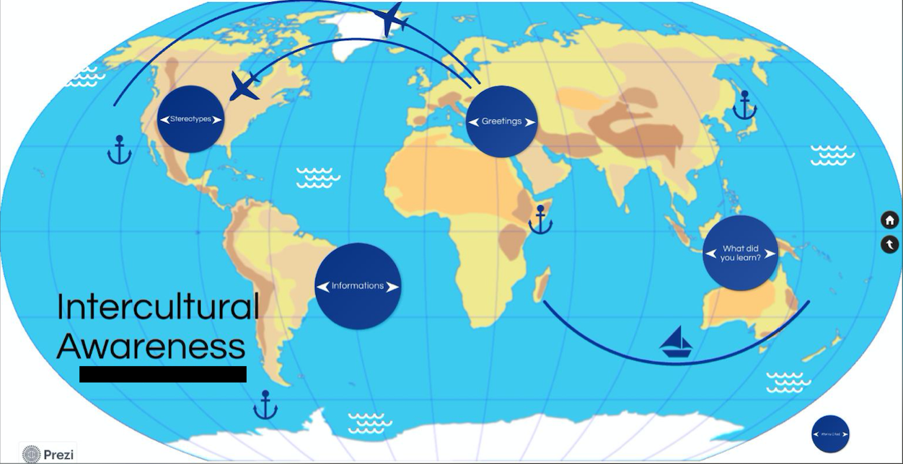

Slide 11
This project is funded by:

